Slide 1
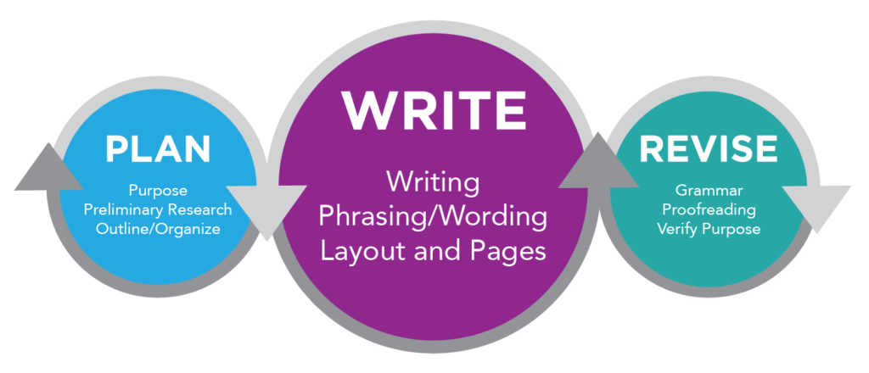
Informal Reports

Slide 2
Understanding Basics of Report
Functions
Informational reports
Analytical Reports
Formats
Letter
Memo
Manuscript
Printed form
Digital
Patterns
Direct
Indirect
Report Delivery
In person
U.S. mail
Fax
E-mail or online
Online
Notes:
If readers are informed If readers are supportive If readers are eager to have results first Direct Pattern Patterns The Direct Pattern
Patterns The Indirect Pattern If readers need to be educated If readers need to be persuaded If readers may be disappointed or hostile Indirect Pattern

Slide 3
Patterns
The Direct pattern
The Indirect Pattern
If readers are informed
If readers need to be educated
If readers are supportive
If readers need to be persuaded
If readers want results first
If readers may be hostile

Slide 4
Reader Response Determines Structure
Reader will likely agree with recommendations
Reader may oppose recommendations
Direct Pattern
Problem
Recommendations
Facts
Discussion
Indirect Pattern
Problem
Facts
Discussion
Recommendations

Slide 5
Guidelines for Developing Informal Reports
Determine problem and purpose.
Gather data.
Organize data.
Write first draft.
Edit and revise.
Where to Gather Data for Reports
Look in records.
Make personal observations.
Use surveys, questionnaires,
Conduct interviews.
Search printed material such as books, newspapers, and periodicals
Search databases/other electronic resources.
Being Objective in Writing Reports
Present both sides of an issue.
Separate fact from opinion.
Be sensitive and moderate in language.
Cite sources carefully.

Slide 6
Informal reports
typically includes the following sections:
Introduction or background
A short section introducing the reader to the “why” of the report.
may include a background, a problem statement, specific objectives.
Support or reasons
Includes facts, findings, and data. present a summary of main ideas from the research—it’s not simply a collection of raw data.
If more detailed data is needed, an appendix is the most likely place .
Conclusion or summary
This short section wraps up the report and gives a quick summary of the information provided therein.
Recommendations
shows how data supports the recommendation.
the author connects the logical data items in a way that points to the recommendation.
Notes:
Remember, the readers are expecting a recommendation with supporting data; they’re not expecting to work through all the data on their own.
In writing your report, remember that headings guide the reader, but like an email subject line, they are no substitute for clear, descriptive writing that helps the reader stay on track. While writing your report, you should use summary statements as each paragraph or section closes to avoid a jerky, disconnected feel in your writing. Ensure that each new section below a header has a good topic sentence that serves as an introduction to the section.

Slide 7
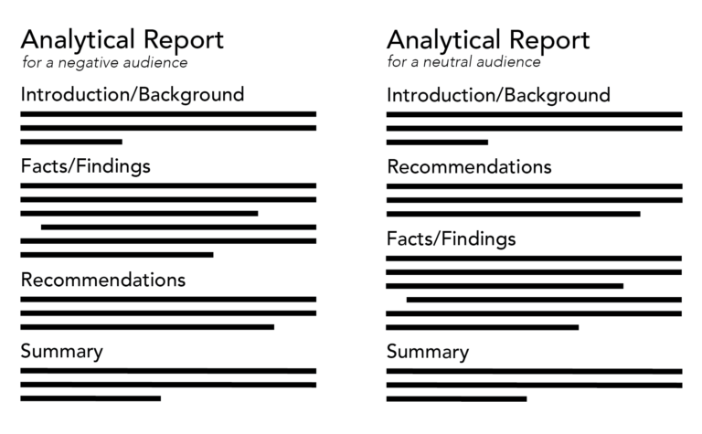
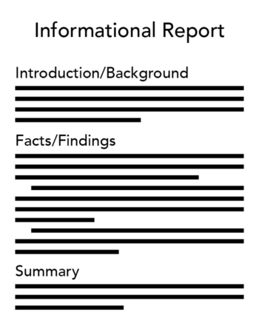

Slide 8
Sophia noticed that the customer check-out lines at her store have become much longer than they used to be on Sundays. Some disgruntled customers have asked why there are so few checkers in the morning on a weekend. Sophia asks her morning manager, Vania, to track the number of customers at each checker stand for the next 30 days and compare it to last year’s numbers. Vania collects the checker stand data and starts her outline for the short report.
Which major sections should her report include?
opening, body, close
introduction, support, summary
introduction, support, recommendations, summary
Chris’s boss, Yasmin, wants to consider changing the work schedule from 40 hours over five days a week to 40 hours over four days a week. She wants to know if this will cause any employee dissatisfaction or increase the cost of overtime. Yasmin tells Chris that other organizations are making this change, and she expects that Chris’s research will find that this change makes sense for increased productivity. Chris expects to write an informal analytical report that Yasmin can use to support her decision to make this change. If Chris finds evidence to support this change, which organizational format makes the most sense for his report?
introduction, recommendation, conclusion
introduction, recommendation, support/reasons, conclusion
introduction, support/reasons, recommendation, conclusion
Notes:
B-introduction, support, summary
If we read the situation carefully, we see that Sophia only asked for the customer data based on the checker stand and the time of day. Other issues were mentioned as possible causes, but they were not to be included in the report. Therefore we know she needs to write an informational report, not an analytical report. These three sections would be common to an informational report. The writer could chose to call the main section “data” rather than “support” to better suit the situation.
B-introduction, recommendation, support/reasons, conclusion
Since the primary audience (Yasmin) supports the change, Chris should introduce the report, state the recommendation, support for the conclusion, and then summarize the report. However, if the research contradicts Yasmin’s initial theory that this change will increase productivity, Chris should reconsider his approach to this report.

Slide 9
No Headings | Using Headings
General Store is opening a new location in Q4 of this upcoming year. There are three potential locations for this new store. In my research, I found that location one is in a poorly trafficked area, but is more affordable. Location two is in a highly trafficked area, but is out of the current budget. Location three is just right. After this research, I can conclude that General Store should open its new store at location three. | Background General Store is opening a new location in Q4 of this upcoming year. There are three potential locations for this new store. Findings Location one is in a poorly trafficked area, but is more affordable. Location two is in a highly trafficked area, but is out of the current budget. Location three is just right. Recommendation General Store should open its new store at location three.
Notes:
USING HEADINGS
Headings can be a useful tool for helping your readers navigate directly to the information they want. Notice that the headings catch your reader’s eye much more easily than phrases such as “in my research . . . ”

Slide 10
Formatting Instructions: Informal Information =Analytical Report
Introduction:
introduce the topic and purpose of the report.
Provide background information /context to help the reader understand the context
Body:
Organize into sections and subsections based on the key points or themes.
Use clear headings and subheadings
Present information logically and coherently, using paragraphs and bullet points as appropriate.
Include evidence, examples, and analysis to support your points.
Use visuals such as charts, graphs, or tables to illustrate data if necessary.
Maintain a conversational tone and avoid overly technical language.
Conclusion:
Summarize main findings and insights
Offer recommendations or suggestions .
References:
Include a list of all sources cited in the report.
Arranged alphabetically by the author's last name.

Slide 11
Formatting Instructions: Informal Information or Analytical Report
General Formatting Guidelines:
Title Page:
Place the title of the report at the top, centred.
include the author's name and submission date
Use a clear, readable font (e.g., Arial, Times New Roman)
font size 12 points
Word count 600 words
Set 1-inch margins on all sides of the page.
Use single spacing within paragraphs and double spacing between paragraphs.
Number pages consecutively, starting with the title page as page 1.
Proofread carefully for spelling, grammar, and punctuation errors.
Save the document in PDF or Word.

Slide 12
Report Presentations
INSTRUCTIONS:
Report on a social issue
Make 10-12 PowerPoint Slides (plus Overview).
Make sure your presentation has all elements of the report
an introduction/background/context
A variety of supporting evidence
summary
recommendations/conclusion
Each group member will present
Paper reading is not encouraged
use of audio-visual aids (30second video clip can be added in the presentation
Time: 15 minutes
You may be asked questions at the end in the Q&A session.

Slide 13
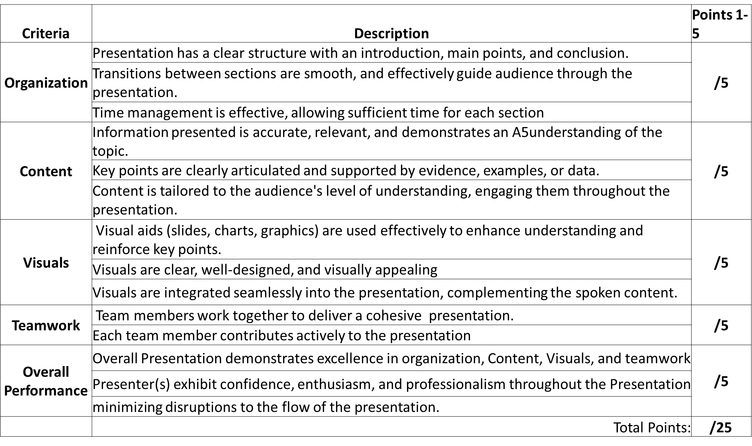
Presentation Rubric

